Slide 1
IoT and Sensors
Budi Rahardjo
2023

Slide 2
Sensors
Get data from real world
Convert them into (digital) values so that they can be read by a processor / controller
Data is shown / stored / sent / processed
Make decision based on data
Example: turn on AC when the temperature is hot, turn off AC when it is cool enough

Slide 3
IoT Sensor Topology
sensor
real world
processor/
controller/
Arduino/
ESP boards
actuator
do something
in the real world
network / internet
database

Slide 4
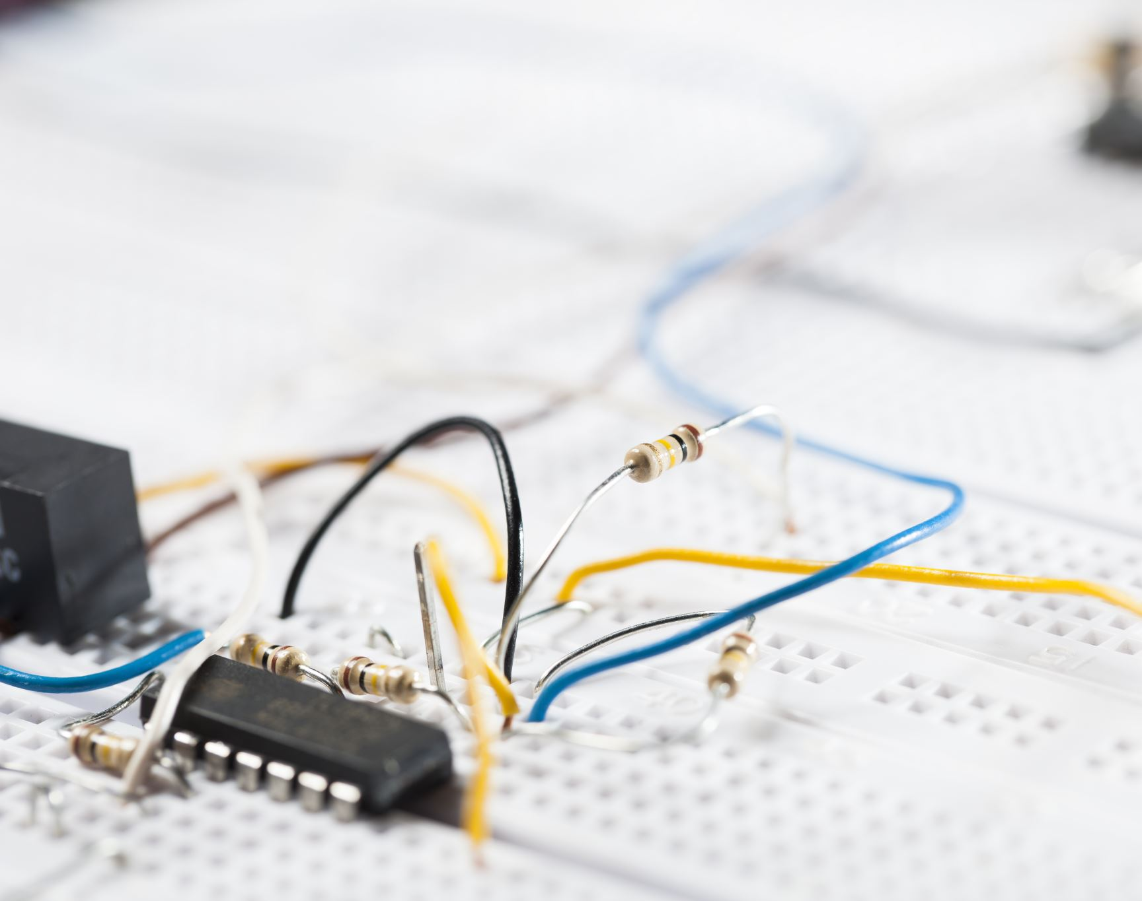
IoT Sensors

Slide 5
IoT Sensors
Temperature & Humidity
DHT-11, DHT-22
Ultrasonic
Measure distance of object
Weight sensor
Light sensor
Soil
Water quality?
Gas sensor
Dust (particle) sensor
Medical sensors
Heart rate
...

Slide 6
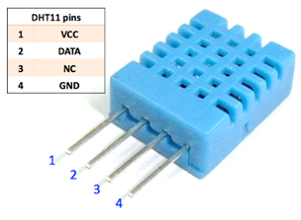
DHT-11 Sensor

Slide 7
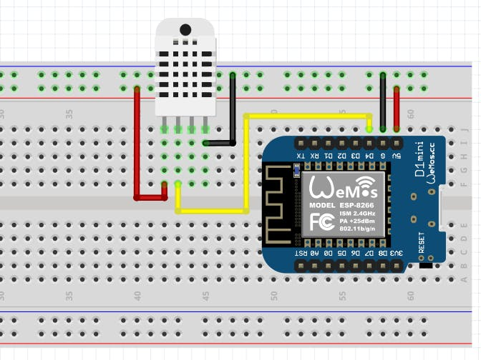

Slide 8
Code
install and load the proper library (DHT-11)
SETUP
set ESP port to receive data (as INPUT)
which port? D4?
LOOP
Read data
Print values

Slide 9
Testing?

